Slide 1
SONNY TIE YOUR TURBAN

Slide 2
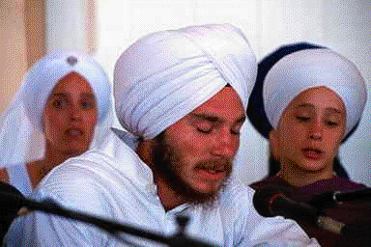
Experience of a parent
My cousin is a millionaire.
His father was among the early immigrants to British Columbia.
He was born and educated in Vancouver.
His parents were of fair color and he is also of very fair color.
He got his CA (Chartered Accountant) degree and later founded his own accounting firm.

Slide 3
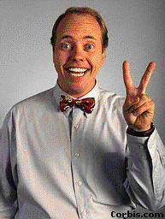
you are not of the white race.”
He cuts his hair, speaks excellent English with a Canadian accent.
His dealers and even employees mistake him for a European.
One day in a meeting with his employees, he mentioned about his East Indian origin.
After hearing this the changed facial expression and later behavior of the Europeans sent him the message,
“Though you are our employer, but you don’t deserve to be equal to us; you are not of the white race.”

Slide 4
Fact of life.
This man, who had been asking,
“Why should Sikhs keep long, shabby hair when they live and work in Canada?
Like other Canadians, they should cut their hair and look clean, neat, and smart.”, suddenly learned a fact of life.

Slide 5
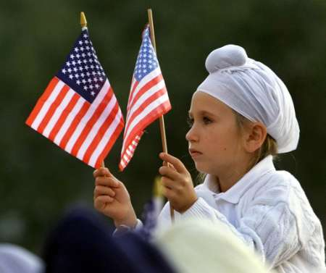
When he came home he advised his young son:
Dear, you must keep your hair and tie your turban.
You should not lose your self-esteem of being a Sikh by cutting your hair.
Look! I pass for a rich European.
My personal looks, my education, and my financial status make me a respectable citizen and an elite person in Vancouver.
But when the Europeans came to know that I am an East Indian they considered me an inferior human being.

Slide 6
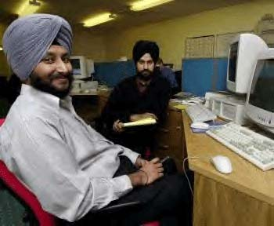
Proud to be a sikh
You may do anything, but white persons will not consider you equal.
Therefore, be a Sikh, look like a Sikh, and be proud of that.
Why disrespect your faith?
Even by doing so, you do not get what you want, ‘equality with the majority’.

Slide 7

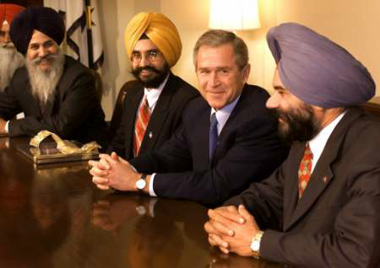
value character and not appearance.
This episode should help remove inferiority complexes in the minds of Sikh youth living in western society.
One must respect his own culture and faith if he wants to be respected by his friends.
If you disregard the principles of your own faith, you lose the respect of the community and also of western people.
If you are a good person, people will respect you regardless of your looks,
They always value your character and not your appearance.

